Slide 1
自督導式學習的神奇能力
李宏毅

Slide 2
Outline
Story 1: Cross-lingual
Story 2: Cross-discipline
Story 3: Pre-training without Human Languages
Notes:
First align, then predict: Understanding the cross-lingual ability of multilingual BERT
An early common hypothesis was that the models take advantage of a common word-piece vocabulary across languages (Wu and Dredze, 2019; Pires et al., 2019), which provides cross-lingual alignment signals to learn useful multilingual representations. However, this hypothesis has been questioned by recent studies (Karthikeyan K and Roth, 2020; Conneau et al., 2020b) which show that shared word-pieces only play a minor role in the performance.
Another line of research suggests that the learning of transferable knowledge happens even in monolingual pretraining. Artetxe et al. (2020) showed that a Transformer encoder pretrained only on L1 exhibits strong cross-lingual transfer performance simply by aligning the L2 embeddings to the encoder

Slide 3
Multi-lingual BERT
Multi-BERT
Multi-BERT
high
est
Mask
Mask
moun
tain
深
度
學
習
Training a BERT model by many different languages.
Notes:
You have an universal token set for all languages.

Slide 4
Zero-shot Reading Comprehension
Training on the sentences of 104 languages
Doc1
Query1
Ans1
Doc2
Query2
Ans2
Doc1
Query1
?
Doc3
Query3
Ans3
Doc3
Query3
?
Doc4
Query4
Ans4
Doc5
Query5
Ans5
Doc2
Query2
?
Train on English QA training examples
Test on Chinese
QA test
Multi-BERT
Notes:
Beto, Bentz, Becas: The Surprising Cross-Lingual Effectiveness of BERT
https://arxiv.org/abs/1904.09077

Slide 5
Zero-shot Reading Comprehension
English: SQuAD, Chinese: DRCD
Model | Pre-train | Fine-tune | Test | EM | F1
QANet | none | Chinese | Chinese | 66.1 | 78.1
BERT | Chinese | Chinese |  | 82.0 | 89.1
 | 104 languages | Chinese |  | 81.2 | 88.7
 |  | English |  | 63.3 | 78.8
 |  | Chinese + English |  | 82.6 | 90.1
F1 score of Human performance is 93.30%
This work is done by 劉記良、許宗嫄
https://arxiv.org/abs/1909.09587

Slide 6
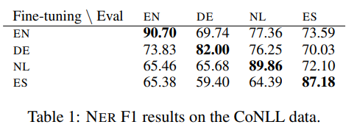
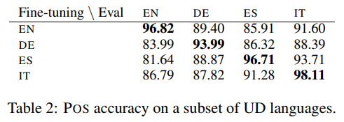
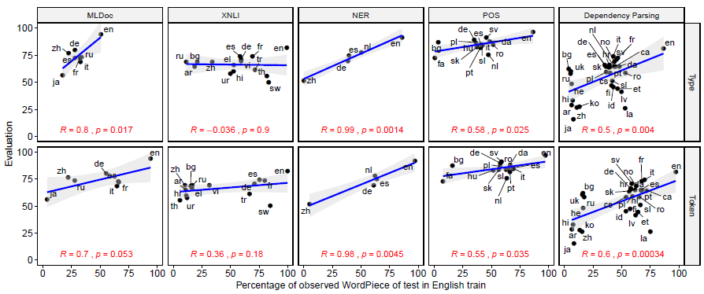
So many evidences ……
https://aclanthology.org/P19-1493/
https://aclanthology.org/D19-1077/
Notes:
perform POS experiments using Universal Dependencies (UD) (Nivre et al., 2016) data for 41 languages.3
Pearson product-moment correlation coefficient，
The P-value is the probability that you would have found the current result if the correlation coefficient were in fact zero (null hypothesis). If this probability is lower than the conventional 5% (P<0.05) the correlation coefficient is called statistically significant.

Slide 7
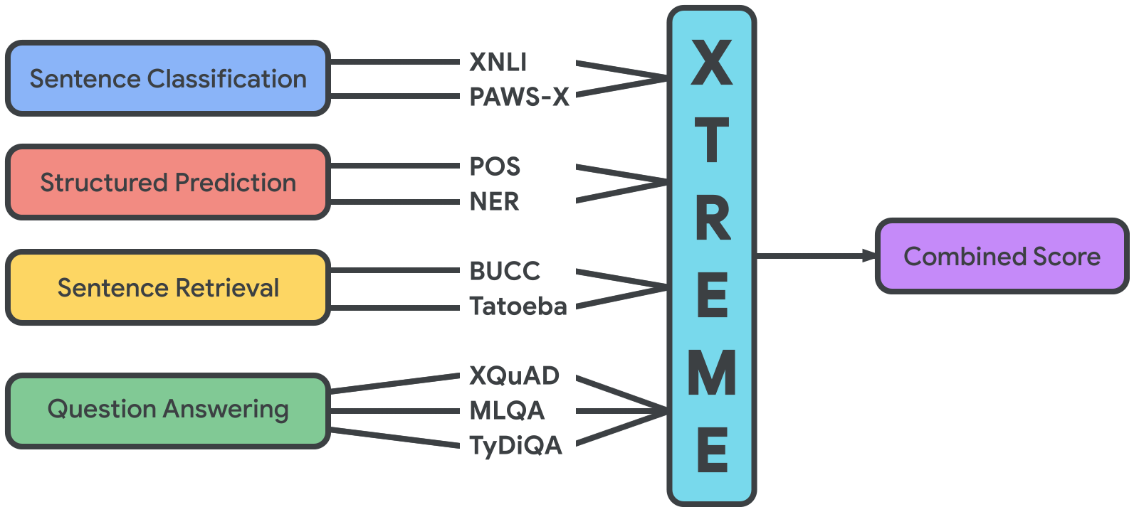
Cross-lingual TRansfer Evaluation of Multilingual Encoders (XTREME) benchmark
https://sites.research.google/xtreme
40 languages for 9 tasks
Train on English, and test on the rest
Notes:
Google Research.
https://github.com/google-research/xtreme?fbclid=IwAR1w_vRslkP0rWdXvjvg6ITbRFELcBQSonSdoRODj4UAAPPdDR1TdvzSZ84
XTREME: A Massively Multilingual Multi-task Benchmark for Evaluating Cross-lingual Generalization
This is a competition

Slide 8
Cross-lingual Alignment?
跳
jump
游
兔
Multi-BERT
swim
rabbit
魚
fish
深
度
學
習
high
est
moun
tain
Notes:
https://www.youtube.com/watch?v=8rDN1jUI82g

Slide 9
How alignment happens?
Typical answer
Different languages share some common tokens.
How do you explain Chinese v.s. English?
Code Switching
Intermediate Language?
… DNA 的構造很像螺旋梯 …
Language X shares tokens with Chinese and English.
(digits, punctuations)
Notes:
=====
need not be aligned to other words. Nonetheless, this assumption is not always true, leading
to misalignment. For example, the English word “the” will most likely also appear in the
training corpus of Spanish, but preferably it should be paired with Spanish words such as
“el” and “la” instead of itself. We refer to this problem as oversharing.
2. It does not utilize any explicit form of seed dictionary as in alignment methods

Slide 10
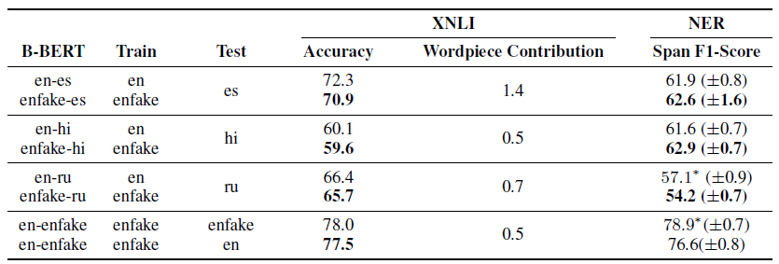
How alignment happens?
https://openreview.net/forum?id=HJeT3yrtDr
English:
the cat is a good cat
Fake-English:
甲
乙
天
地
人
乙
Notes:
There is more …
1911.02116
1910.11856
However, Wang et al. (2019b) dispute this account, showing that bilingual BERT models are not hampered by the lack of shared vocabulary.
Artetxe et al. (2019) also show crosslingual transfer is possible by swapping the model vocabulary, without any shared word-pieces.
https://openreview.net/forum?id=HJeT3yrtDr

Slide 11
https://arxiv.org/abs/2010.10041
Weird???
深
度
學
習
high
est
moun
tain
跳
jump
游
Reconstruction
兔
swim
rabbit
魚
fish
If the embedding is language independent …
Multi-BERT
How to correctly reconstruct?
There must be language information.
深
度
學
習
high
est
moun
tain

Slide 12
This work is done by 劉記良、許宗嫄、莊永松
Where is Language?
那
有
一
貓
跳
jump
Reconstruction
游
兔
swim
rabbit
魚
+
+
+
+
fish
Average of Chinese
Multi-BERT
Average of English
there
is
a
cat

Slide 13
This work is done by 劉記良、許宗嫄、莊永松
If this is true …
https://arxiv.org/abs/2010.10041
跳
jump
Average of Chinese
游
兔
swim
$α$x
rabbit
魚
Average of English
fish
Unsupervised token-level translation ☺

Slide 14
This work is done by 劉記良、許宗嫄、莊永松
https://arxiv.org/abs/2010.10041
Unsupervised token-level translation ☺

Slide 15
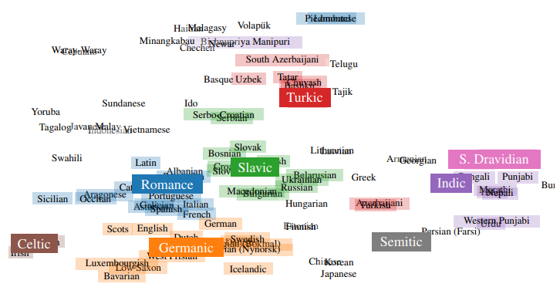
On the Language Neutrality of Pre-trained Multilingual Representations
https://arxiv.org/abs/2004.05160

Slide 16
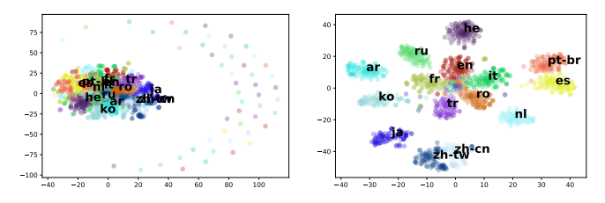
It’s not Greek to mBERT: Inducing Word-Level Translations from Multilingual BERT
https://arxiv.org/abs/2010.08275

Slide 17
Zero-shot Cross-lingual Transfer
Train on English
Test on Chinese
Downstream
Downstream
different?
Multi-BERT
Multi-BERT
high
est
moun
tain
深
度
學
習

Slide 18
Average of English
Test on Chinese
Average of Chinese
Downstream
Train on English
Downstream
+
+
+
+
Similar?
Multi-BERT
Multi-BERT
high
est
moun
tain
深
度
學
習
Notes:
Only manipulating the embedding during inference, do not cha

Slide 19
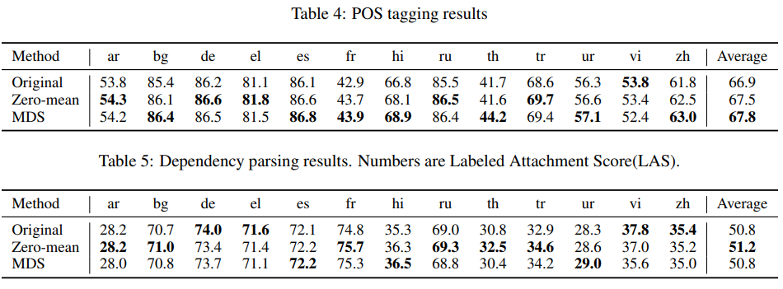
Experimental Results

Slide 20
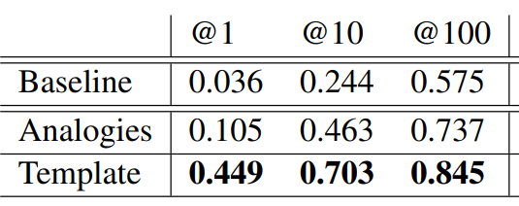
You just have to ask ……
It’s not Greek to mBERT: Inducing Word-Level Translations from Multilingual BERT
https://arxiv.org/abs/2010.08275
???
Multi-BERT
The
word
apple
in
French
is
[MASE]

Slide 21
Outline
Story 1: Cross-lingual
Story 2: Cross-discipline
Story 3: Pre-training without Human Languages
Notes:
First align, then predict: Understanding the cross-lingual ability of multilingual BERT
An early common hypothesis was that the models take advantage of a common word-piece vocabulary across languages (Wu and Dredze, 2019; Pires et al., 2019), which provides cross-lingual alignment signals to learn useful multilingual representations. However, this hypothesis has been questioned by recent studies (Karthikeyan K and Roth, 2020; Conneau et al., 2020b) which show that shared word-pieces only play a minor role in the performance.
Another line of research suggests that the learning of transferable knowledge happens even in monolingual pretraining. Artetxe et al. (2020) showed that a Transformer encoder pretrained only on L1 exhibits strong cross-lingual transfer performance simply by aligning the L2 embeddings to the encoder

Slide 22
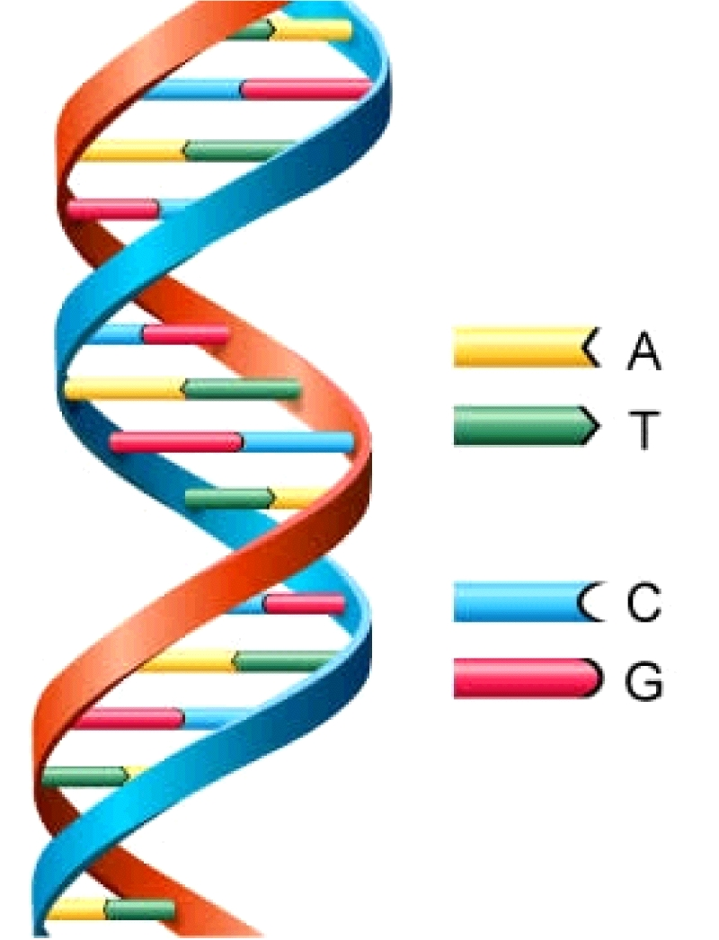
Why does BERT work?
https://arxiv.org/abs/2103.07162
This work is done by 高瑋聰
Applying BERT to protein, DNA, music classification
EI CCAGCTGCATCACAGGAGGCCAGCGAGCAGGTCTGTTCCAAGGGCCTTCGAGCCAGTCTG
EI AGACCCGCCGGGAGGCGGAGGACCTGCAGGGTGAGCCCCACCGCCCCTCCGTGCCCCCGC
IE AACGTGGCCTCCTTGTGCCCTTCCCCACAGTGCCCTCTTCCAGGACAAACTTGGAGAAGT
IE CCACTCAGCCAGGCCCTTCTTCTCCTCCAGGTCCCCCACGGCCCTTCAGGATGAAAGCTG
IE CCTGATCTGGGTCTCCCCTCCCACCCTCAGGGAGCCAGGCTCGGCATTTCTGGCAGCAAG
IE AGCCCTCAACCCTTCTGTCTCACCCTCCAGCCTAAAGCTCCTTGACAACTGGGACAGCGT
IE CCACTCAGCCAGGCCCTTCTTCTCCTCCAGGTCCCCCACGGCCCTTCAGGATGAAAGCTG
N CTGTGTTCACCACATCAAGCGCCGGGACATCGTGCTCAAGTGGGAGCTGGGGGAGGGCGC
N GTGTTACCGAGGGCATTTCTAACAGTCTTCTTACTACGGCCTCCGCCGACCGCGCGCTCG
N TCTGAGCTCTGCATTTGTCTATTCTCCAGCTGACCCTGGTTCTCTCTCTTAGCTACCTGC
class
DNA sequence

Slide 23
Why does BERT work?
https://arxiv.org/abs/2103.07162
This work is done by 高瑋聰
class
Linear
Random initialization
pre-train on English
Init by pre-train
A | we
T | you
C | he
G | she
BERT
[CLS]
we
she
we
he
DNA sequence
A
G
A
C

Slide 24
Why does BERT work?
https://arxiv.org/abs/2103.07162
This work is done by 高瑋聰
Applying BERT to protein, DNA, music classification
Notes:
https://ppfocus.com/hk/0/di75f00e4.html

Slide 25
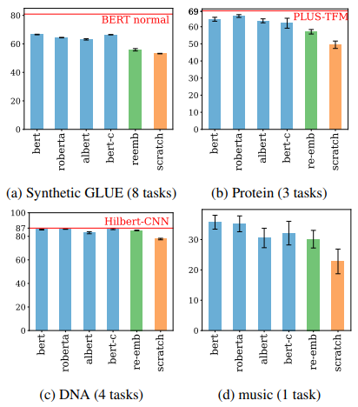
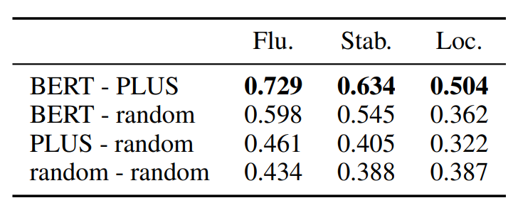

Slide 26
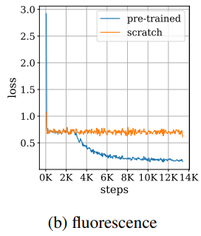
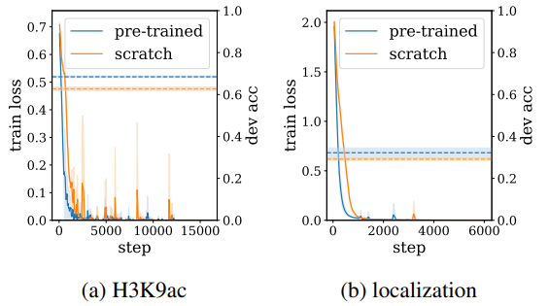
Optimization
Generalization

Slide 27
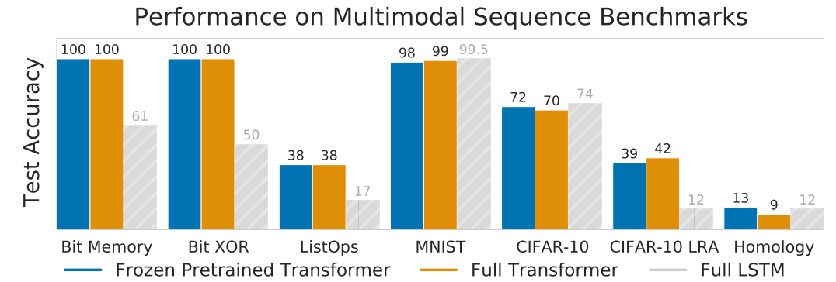
Self-supervised Model as Universal Computation Engine

Slide 28
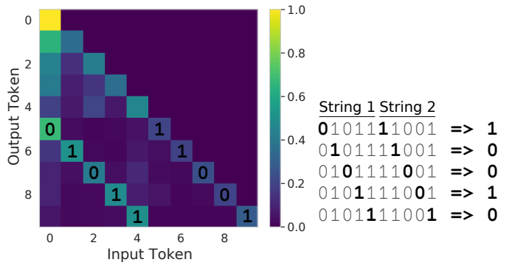

Slide 29
這些發現有甚麼用？
Speech Question Answering

Slide 30
TOEFL Listening Comprehension Test by Machine
Link: https://github.com/iamyuanchung/TOEFL-QA
https://arxiv.org/abs/1608.06378
(The original story is 5 min long.)
Audio Story:
Question: “ What is a possible origin of Venus’ clouds? ”
Choices:
(A) gases released as a result of volcanic activity
(B) chemical reactions caused by high surface temperatures
(C) bursts of radio energy from the plane's surface
(D) strong winds that blow dust into the atmosphere
Notes:
tester

Slide 31
SQuAD-style Spoken QA
https://arxiv.org/abs/1804.00320
https://arxiv.org/abs/1808.02280
Link: https://github.com/chiahsuan156/ODSQA
SPOKEN OPEN-DOMAIN QUESTION ANSWERING DATASET

Slide 32
SQuAD-style Spoken QA
Link: https://github.com/chiahsuan156/ODSQA
SPOKEN OPEN-DOMAIN QUESTION ANSWERING DATASET
SOD QA
OPEN-DOMAIN SPOKEN QUESTION ANSWERING DATASET
ODS QA
[Lee, et al., SLT’18]

Slide 33
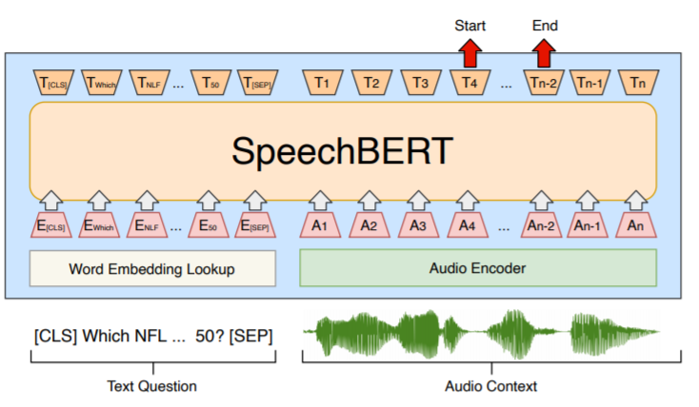
Towards End-to-end
https://arxiv.org/abs/1910.11559

Slide 34
Speech Question Answering
Training data
ans span
$$q_{1}$$
$$d_{1}$$
ans span
$$q_{2}$$
$$d_{2}$$
ans span
$$q_{3}$$
$$d_{3}$$
(no speech transcription )
Can we train an end-to-end speech QA model?

Slide 35
Speech Question Answering
start
end
It does not work …..
No semantic information
Find Ans Span
Pre-trained Speech Model
[CLS]
[SEP]
question
document
Notes:
determining whether a “hypothesis” is true (entailment), false (contradiction), or undetermined (neutral) given a “premise”.

Slide 36
start
end
It does not work …..
Find Ans Span
VQ
3
9
3
7
11
31
31
Pre-trained Speech Model
[CLS]
[SEP]
question
document
Notes:
determining whether a “hypothesis” is true (entailment), false (contradiction), or undetermined (neutral) given a “premise”.

Slide 37
start
end
No pre-train: 6.12 F1 score $→$
Pre-training on text: 54.22 F1 score
Find Ans Span
BERT (pre-trained on text)
VQ
3
9
3
7
11
31
31
Pre-trained Speech Model
[CLS]
[SEP]
question
document
Notes:
determining whether a “hypothesis” is true (entailment), false (contradiction), or undetermined (neutral) given a “premise”.

Slide 38
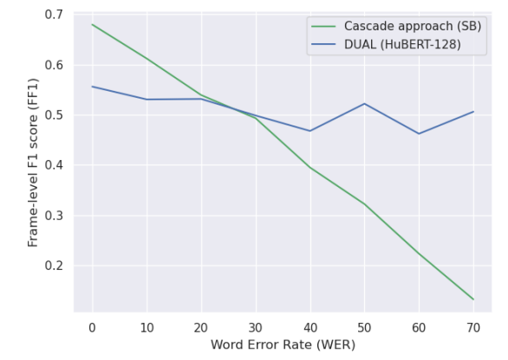
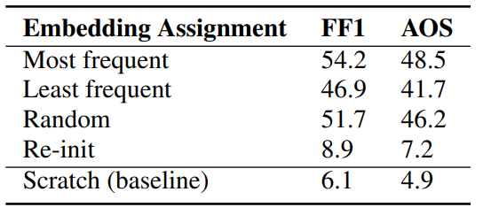
Speech Question Answering
https://arxiv.org/abs/2203.04911
This work is done by 林冠廷
Speech QA
without Speech Recognition
Speech Recognition + Text-based QA

Slide 39
Outline
Case Study: BERT
Story 1: Cross-lingual
Story 2: Cross-discipline
Story 3: Pre-training without Human Languages
Notes:
Dan’s paper
Pretraining with Artificial Language: Studying Transferable Knowledge in Language Models
https://arxiv.org/abs/2203.10326
ACL
Surprisingly, the transfer happens without lexical overlaps between L1 and L2 (Karthikeyan K and Roth, 2020; Conneau et al., 2020b) or even without joint pretraining (Artetxe et al., 2020)
t multilingual BERT captures languageindependent linguistic structures such as universal dependency relations (Chi et al., 2020) and subjecthood (Papadimitriou et al., 2021)
A typical experimental framework is as follows: (1) create an artificial language that differs from a natural language in one linguistic property, such as word orders (Sinha et al., 2021b; Dufter and Schütze, 2020; Sinha et al., 2021a), scripts (Karthikeyan K and Roth, 2020; Dufter and Schütze, 2020; Conneau et al., 2020b), or morphology (Ravfogel et al., 2019); (2) train or evaluate the natural/artificial language models and compare the performance to analyze the model’s sensitivity to the linguistic property.
, because in natural language, dependency relations usually hold between different words (e.g., I and am). We will show that this difference is in fact crucial and draw a different conclusion from Papadimitriou and Jurafsky (2020) on the importance of the nested structure
Jennifer C. White and Ryan Cotterell. 2021. Examining the Inductive Bias of Neural Language Models with Artificial Languages.

Slide 40
Pre-training on Artificial Data
By defining different rules, we know what are the key factors for the success of pre-training.
……
Token generation by rules
1
2
1
1
7
7
3
9
3
6
5
4
……
Pre-train
English downstream tasks
BERT
Fine-tune
Notes:
Ref: Learning music helps you read: Using transfer to study linguistic structure in language models

Slide 41
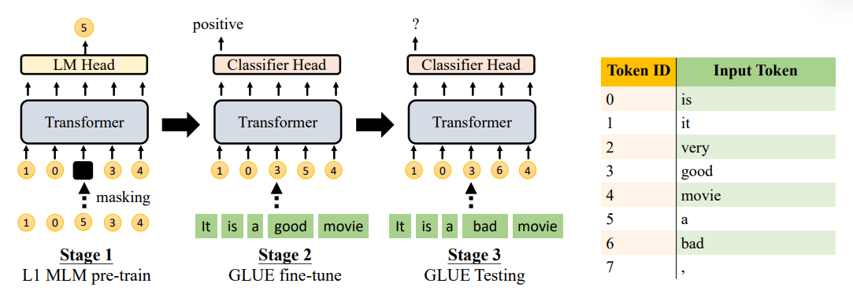

Slide 42
Pre-training on Artificial Data
https://arxiv.org/abs/2109.03537
This work is done by 姜成翰
GLUE score improvement vs. train from scratch
Notes:
How to map

Slide 43
Pre-training on Artificial Data
https://arxiv.org/abs/2109.03537
This work is done by 姜成翰
GLUE score improvement vs. train from scratch
Pre-training on random generated words yields the same performance as training from scratch.
Data plays the role.
Notes:
How to map

Slide 44
Data is critical ……
Learn more from robust wav2vec 2.0
https://arxiv.org/abs/2104.01027
Pre-trained Model
Labeled
Data
Testing
Data
HuBERT (Librispeech)
e.g., clean
e.g., noisy

Slide 45
Data is critical ……
Learn more from robust wav2vec 2.0
https://arxiv.org/abs/2104.01027
Pre-trained Model
Labeled
Data
Testing
Data
Continuously train with noisy data
HuBERT (Librispeech)
e.g., clean
e.g., noisy

Slide 46
Pre-training on Artificial Data
https://arxiv.org/abs/2109.03537
This work is done by 姜成翰
GLUE score improvement vs. train from scratch
Pre-training on random generated words yields the same performance as training from scratch.
Data plays the role.
Pre-training from the data generated by unigram or bi-gram LMs helps a little.
Notes:
How to map

Slide 47
Pre-training on Artificial Data
https://arxiv.org/abs/2109.03537
This work is done by 姜成翰
GLUE score improvement vs. train from scratch
The sentences generated by very simple rules can lead to good pre-trained models.
All the words in the generated sentences are paired.
Also refer to:
Learning Music Helps You Read: Using Transfer to Study Linguistic Structure in Language Models
https://arxiv.org/abs/2004.14601
Notes:
How to map

Slide 48
Pre-training on Artificial Data
https://arxiv.org/abs/2109.03537
This work is done by 姜成翰
GLUE score improvement vs. train from scratch
The sentences generated by very simple rules can lead to good pre-trained models.
All the words in the generated sentences are paired.
Shuffle
…
1
2
3
63
64
…
57
9
5
22
43
Notes:
How to map

Slide 49
Concluding Remarks
Story 1: Cross-lingual
Story 2: Cross-discipline
Story 3: Pre-training without Human Languages
Notes:
First align, then predict: Understanding the cross-lingual ability of multilingual BERT
An early common hypothesis was that the models take advantage of a common word-piece vocabulary across languages (Wu and Dredze, 2019; Pires et al., 2019), which provides cross-lingual alignment signals to learn useful multilingual representations. However, this hypothesis has been questioned by recent studies (Karthikeyan K and Roth, 2020; Conneau et al., 2020b) which show that shared word-pieces only play a minor role in the performance.
Another line of research suggests that the learning of transferable knowledge happens even in monolingual pretraining. Artetxe et al. (2020) showed that a Transformer encoder pretrained only on L1 exhibits strong cross-lingual transfer performance simply by aligning the L2 embeddings to the encoder

